Slide 1

Diabetes Detection using Deep Learning
Presented by :
Namreen Habib (2100971640034)
Parantap Pandey (2100971640036)
Sarthak Bhandari (2100971640044)
Guided by: Mr. Sunny Arora

Slide 2
Outline
Department of CSE and Allied Branches
Introduction
Problem Statement
Objectives
Literature Survey
Dataset Details
Data Preprocessing
Methodology
Model Comparison
Proposed Work
XAI Integration
Conclusion
Future Scope

Slide 3
Introduction
Department of CSE and Allied Branches
Overview of the Problem:
Diabetes is a chronic condition affecting millions globally. Early detection is key to managing its progression and improving patient outcomes. AI models can assist in predicting diabetes risk, offering an efficient solution for timely intervention.
Importance of Early Diagnosis and Interpretability:
Early diagnosis allows for preventive measures and treatment, reducing complications. In healthcare AI, model interpretability is crucial for gaining the trust of healthcare professionals. Transparent predictions help medical practitioners understand the factors influencing results, ensuring better decision-making.
Current Approaches in Diabetes Detection
Traditional methods like Fasting Blood Sugar (FBS) and OGTT detect diabetes later, while AI models can identify early signs by analyzing health data. Machine learning algorithms, especially neural networks, offer better accuracy in predicting diabetes risk.
Benefits of AI in Healthcare
AI speeds up diagnosis, enabling faster diabetes detection. It also provides personalized healthcare by identifying individual risks and suggesting tailored treatments. AI’s scalability makes it efficient in large healthcare systems, improving patient outcomes.

Slide 4
Diabetes is a rapidly growing health issue worldwide, leading to serious complications if not detected early. Traditional diagnostic methods, while effective, are often slow and resource-heavy, which can delay timely intervention.
This project aims to improve diabetes detection by applying deep learning techniques, which can provide faster and more accurate predictions. Using the Framingham dataset, the model achieves high accuracy and integrates Explainable AI (XAI) with SHAP to ensure transparency in the decision-making process. This approach helps healthcare professionals understand the model’s predictions, making it more reliable and accessible for real-world applications.
Department of CSE and Allied Branches
Problem Statement

Slide 5
Objectives
Department of CSE and Allied Branches
The primary objectives of this project are as follows:
Build an Accurate Diabetes Detection Model
Develop a deep learning model using the Framingham dataset to predict diabetes risk with high accuracy.
Integrate Explainable AI (XAI)
Use SHAP to provide interpretable predictions and enhance model transparency for healthcare professionals.
Support Healthcare Decision-Making
Offer insights to help doctors make informed, data-driven decisions on diabetes management.
Achieve Model Performance
Aim for high accuracy and optimize the model for reliable diabetes prediction.
Ensure Practical and Scalable Use
Design the model for real-world healthcare application and scalability across diverse patient populations.

Slide 6
Literature Survey
Department of CSE and Allied Branches
Traditional Machine Learning Models
Logistic Regression & SVM: Widely used for diabetes prediction, these models offer decent accuracy (80-85%) but struggle with interpretability and handling complex data patterns.
Limitations: While effective, these models often miss the intricate relationships between features, leading to lower accuracy and limited real-world applicability.
Deep Learning Approaches
Neural Networks: Recent studies show that deep learning models, particularly neural networks, outperform traditional methods, providing higher accuracy in predicting diabetes.
Advantages: Neural networks can capture complex, non-linear relationships in data, improving prediction accuracy, especially with large datasets like the Framingham dataset.
Explainable AI (XAI)
SHAP: SHapley Additive exPlanations (SHAP) has gained popularity for improving transparency in deep learning models. It allows healthcare professionals to understand feature contributions to predictions, enhancing trust in AI.

Slide 7
Literature Survey
Department of CSE and Allied Branches
Importance in Healthcare
XAI is crucial in medical applications, where understanding model decisions can directly impact patient care and treatment strategies.
Integration of Deep Learning and XAI
Combined Approach: Some recent studies combine deep learning with XAI techniques like SHAP to achieve both high accuracy and interpretability, addressing the need for reliable and transparent models in healthcare.
Outcome: These integrated models show great promise in not only predicting diabetes with high accuracy but also explaining the factors influencing the predictions, making them more suitable for practical use in healthcare.

Slide 8
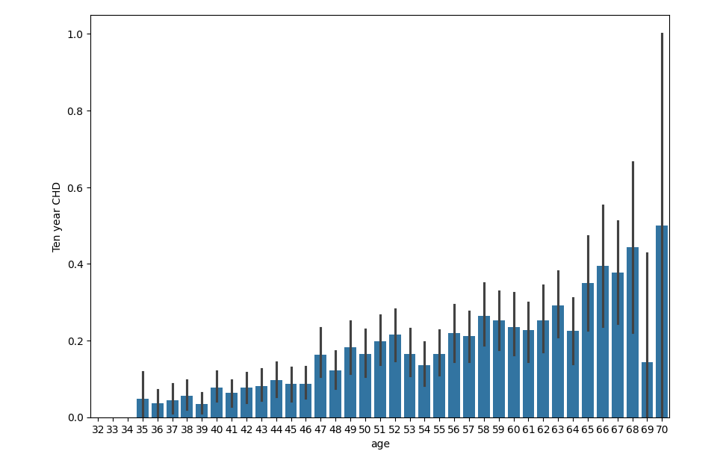
Literature Survey
Department of CSE and Allied Branches
This graph shows the trend between Age and Diabetes. We can see that with increasing age, the risk of diabetes also increases significantly.

Slide 9
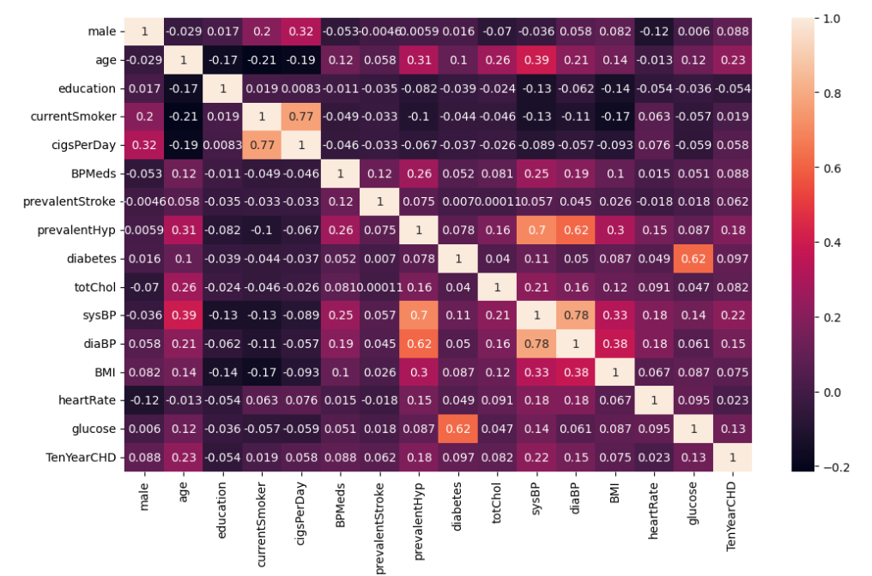
Literature Survey
Department of CSE and Allied Branches
This confusion matrix shows the attribute’s correlation with the outcome for the raw and pre-processed Framingham dataset.

Slide 10
Dataset Details
Department of CSE and Allied Branches
Basic Details:
Source: The dataset is from the Framingham Heart Study, a long-term study focused on cardiovascular disease and diabetes.
Features: It includes features such as age, blood pressure, cholesterol levels, BMI, smoking habits, physical activity, and alcohol consumption.
Target Variable: The primary target variable is whether or not a person develops diabetes, based on various health indicators.
Data Type: The dataset contains numerical values for health indicators and categorical data for lifestyle factors.
Initial Data Structure:
The dataset has 4,240 records and 16 features.
Features cover key health aspects like age, BMI, blood pressure, and lifestyle behaviors.
These features are crucial in predicting diabetes risk, providing a well-rounded view of the patient’s health.

Slide 11
Data Preprocessing
Department of CSE and Allied Branches
Handling Missing Data:
Missing values were filled using Min-Max Scaling, normalizing data to a uniform range (0 to 1) and maintaining consistency across features.
Duplicate Removal:
Duplicate records were removed to avoid redundancy and overfitting, ensuring each record is unique and improving model accuracy.
Feature Selection:
Irrelevant features were removed to focus on the most impactful variables, simplifying the model and enhancing performance.
Scaling and Normalization:
Min-Max Scaling was applied to normalize features, preventing larger values from dominating the model and speeding up training.
Final Dataset:
After preprocessing, the dataset was reduced to 4044 records with 14 features, ready for model training with clean, balanced data.

Slide 12
Methodology
Department of CSE and Allied Branches
Train-Test Split:
The data was split into 80% for training and 20% for testing. This approach ensures that the model is evaluated on unseen data, improving its generalization and ability to perform on real-world data.
Algorithms Used:
Various machine learning algorithms were tested, including:
Logistic Regression
Support Vector Machine (SVM)
Decision Trees
Random Forest
Gaussian Naive Bayes Algorithm
These models were evaluated for their ability to predict diabetes, with accuracy as the primary metric. Their performance was compared to identify the most suitable algorithm for this task.

Slide 13
Methodology
Department of CSE and Allied Branches
Neural Network Integration
Deep Learning Approach:
To further improve prediction accuracy, neural networks were implemented using TensorFlow. The neural network model leverages layers of interconnected neurons to automatically learn complex patterns in the data. This deep learning approach showed a significant improvement in predictive performance compared to traditional machine learning models, achieving an accuracy of 88.34%.
Advantages of Neural Networks:
Neural networks are particularly effective for tasks involving complex, non-linear relationships between features. In this project, the model was able to capture intricate patterns related to diabetes risk that simpler models could not. This resulted in higher prediction accuracy and a more reliable tool for healthcare professionals.

Slide 14
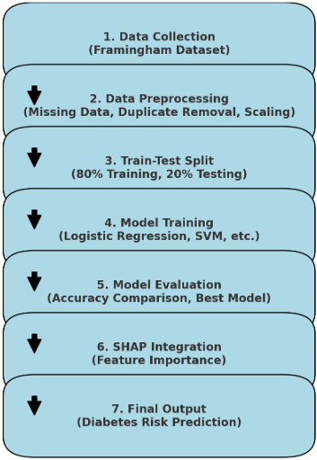
Methodology
Department of CSE and Allied Branches
This flowchart provides a clear and structured overview of the entire diabetes detection project. It breaks down the key steps involved in the process, from data collection to the final output. The flowchart helps to visualize the stages, including data preprocessing, model training, evaluation, and the integration of Explainable AI (XAI) for better interpretability. By following this flow, it becomes easier to understand how each component contributes to predicting diabetes risk and how the project achieves its goal of providing accurate and explainable results for healthcare professionals.

Slide 15
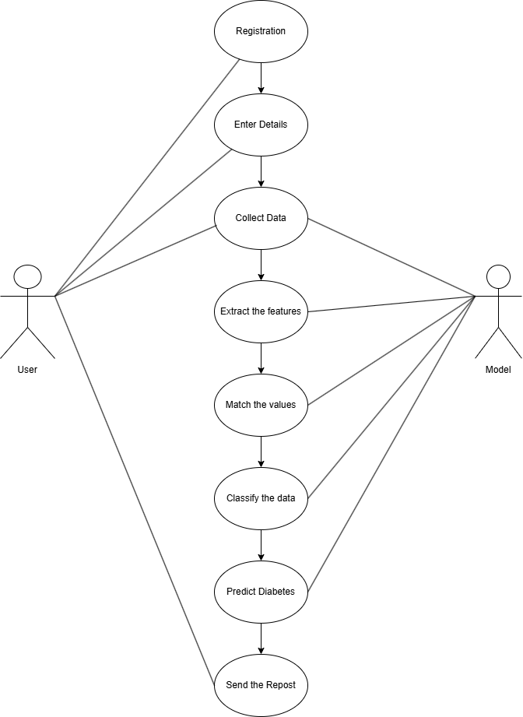
Methodology
Department of CSE and Allied Branches
The use case diagram shows how healthcare professionals, data scientists, and the system interact. Healthcare professionals input patient data, receive predictions, and use the XAI feature to understand model decisions. Data scientists handle data preprocessing, model training, and evaluation. The system generates predictions and provides explanations using SHAP, ensuring transparency and aiding informed decision-making in diabetes prediction and care.

Slide 16
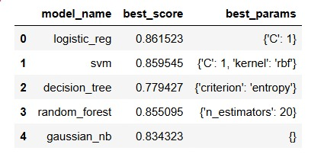
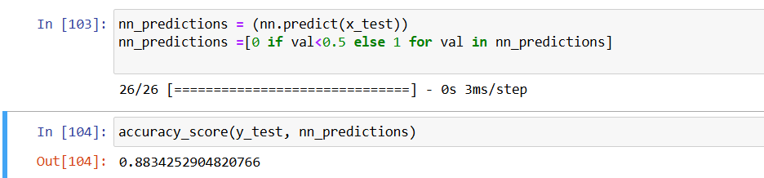
Model Comparison
Department of CSE and Allied Branches
Accuracy Comparison:
Several models were tested and compared based on prediction accuracy for diabetes detection:
  Logistic Regression: 86.15% accuracy.
  Support Vector Machine (SVM): 85.95% accuracy.
  Decision Trees: 77.94% accuracy (lowest performance due to overfitting).
  Random Forest: 85.50% accuracy.
  Gaussian Naïve Bayes: 83.43% accuracy.
In summary, the Neural Network achieved the highest accuracy, demonstrating its ability to capture complex patterns in the data for more precise predictions.

Slide 17
Proposed Work
Department of CSE and Allied Branches
Neural Network Architecture:
  The model was built using TensorFlow, with an input layer for data features, multiple hidden layers to learn complex patterns, and an output layer for classification.
  ReLU activation functions were used in the hidden layers to help the model capture non-linear relationships in the data.
Performance:
  The neural network achieved 88.34% accuracy, outperforming traditional machine learning models like logistic regression and SVM.
  This high accuracy shows the model's ability to predict diabetes risk with confidence, making it a useful tool for early detection in healthcare.

Slide 18
XAI Integration
Department of CSE and Allied Branches
Role of SHAP:
SHAP values break down model predictions into contributions from each feature.
It assigns each feature a score that shows its impact on the model's decision.
Helps healthcare professionals understand which factors are most influential in predicting diabetes risk.
Provides transparency in AI decisions, ensuring the model's reasoning is clear and interpretable.
Benefits for Healthcare Professionals:
SHAP explains why a particular prediction is made, helping doctors make more informed decisions.
It offers insights into the key health factors influencing diabetes risk, aiding early diagnosis.
By visualizing feature importance, doctors can prioritize interventions for patients based on their risk factors.
The interpretability fosters trust in the AI model, increasing its acceptance in clinical settings.

Slide 19
Conclusion
Department of CSE and Allied Branches
The neural network model achieved an impressive accuracy of 88.34%, demonstrating its strong capability in predicting diabetes risk based on the Framingham dataset. This high accuracy indicates that the model can effectively identify individuals at risk, outperforming traditional machine learning algorithms such as Logistic Regression and SVM. The results highlight the potential of deep learning in medical diagnostics, offering a reliable tool for early detection. With its strong predictive performance, the model holds promise for aiding healthcare professionals in making informed decisions and improving patient outcomes.

Slide 20
Future Scope
Department of CSE and Allied Branches
The model can be improved by integrating more data sources like genetics and real-time health metrics for better accuracy. Deploying it in healthcare settings for continuous monitoring could enable early interventions. Advancements in explainable AI could enhance its interpretability, while expanding the model to detect other diseases would broaden its utility. Additionally, making it accessible through mobile apps could improve reach, especially in underserved areas.

Slide 21
Thank You.
Department of CSE and Allied Branches

Slide 22
References
Department of CSE and Allied Branches
Hasan, Md. K., Alam, Md. A., Das, D., Hossain, E., & Hasan, M. (2020). Diabetes Prediction Using Ensembling of Different Machine Learning Classifiers. IEEE Access, 8, 76516–76531. https://doi.org/10.1109/access.2020.2989857
G Parimala, R. Kayalvizhi, & S. Nithiya. (2023). Diabetes Prediction using Machine Learning. https://doi.org/10.1109/iccci56745.2023.10128216
S, J., N, B., P, S., K, S. K., & Mani Nageshwar, V. (2022, March 1). Diabetes Prediction Using Machine Learning Algorithms. IEEE Xplore. https://doi.org/10.1109/ICACCS54159.2022.9785073
Dubey, Y., Wankhede, P., Borkar, T., Borkar, A., & Mitra, K. (2021). Diabetes Prediction and Classification using Machine Learning Algorithms. 2021 IEEE International Conference on Biomedical Engineering, Computer and Information Technology for Health (BECITHCON). https://doi.org/10.1109/becithcon54710.2021.9893653
Sarwar, M. A., Kamal, N., Hamid, W., & Shah, M. A. (2018, September 1). Prediction of Diabetes Using Machine Learning Algorithms in Healthcare. IEEE Xplore. https://doi.org/10.23919/IConAC.2018.8748992
Digey, B. (2021). DIABETES DETECTION USING CONVOLUTIONAL NEURAL NETWORKS (CNN) BASED MODEL [Research Article]. Turkish Journal of Computer and Mathematics Education, 12(14), 6007–6016.
G., S., R., V., & K.P., S. (2018). Diabetes detection using deep learning algorithms. ICT Express, 4(4), 243–246. https://doi.org/10.1016/j.icte.2018.10.005
Al-Khafajiy, M., Baker, T., Chalmers, C. et al. Remote health monitoring of elderly through wearable sensors. Multimed Tools Appl 78, 24681–24706 (2019). https://doi.org/10.1007/s11042-018-7134-7

